Slide 1



Slide 2
CNIR
wEB based APPLICATION
CONTEXTUAL NEWS INFORMATION RETRIVAL

Slide 3
GROUP MEMBERS
01
Mirza Faizan Ahmed (11349)
02
Annas Israr(11327)
03
Zain ul Abdein (11350)
04
Yaldrum Shezad (11319)

Slide 4
INTORDUCTION
NEWS EXTRACTION
web application designed to provide authentic news from valid source reduces time and effort of user
Specificaly designed for latest news
Documentated NEWS
WEB SCRAPPING
Data scrapped would be in docuumented form
Use techniques of web scrappers to extract relevant data

Slide 5
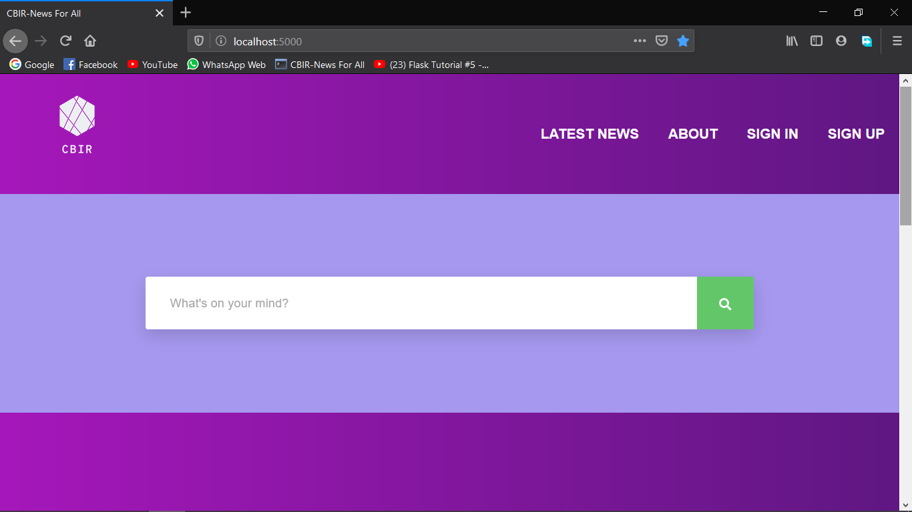
LANDING PAGE
WELCOME TO THE LANDING PAGE OF CNIR
It provides search bar option
user can sign in /sign up
Latest News option

Slide 6
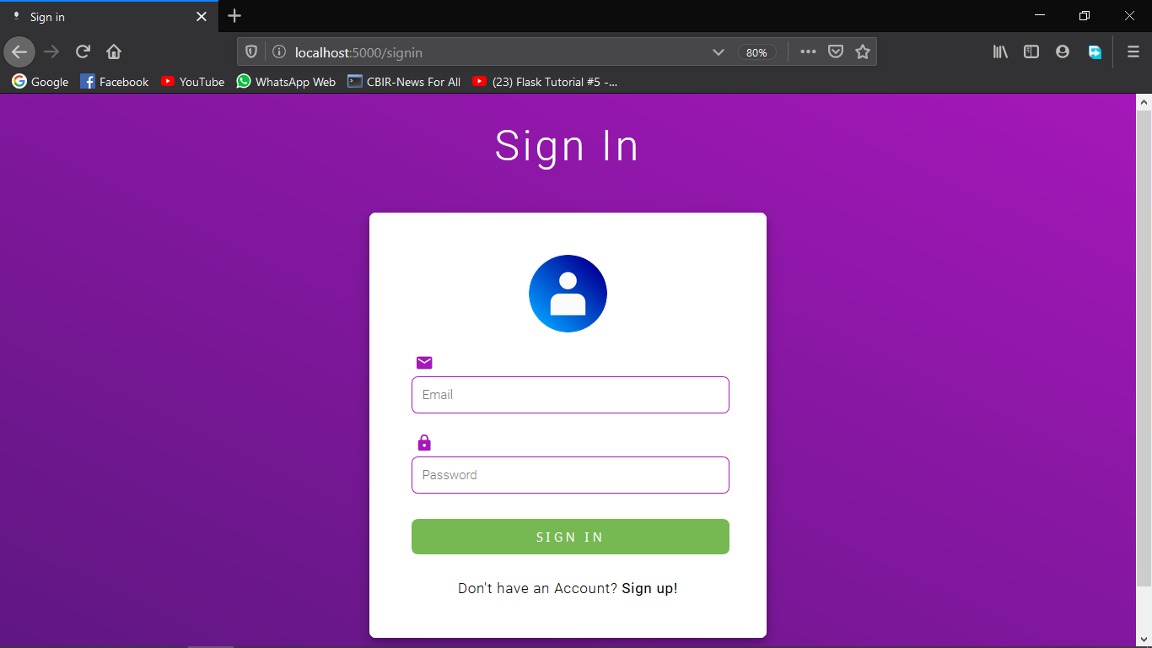
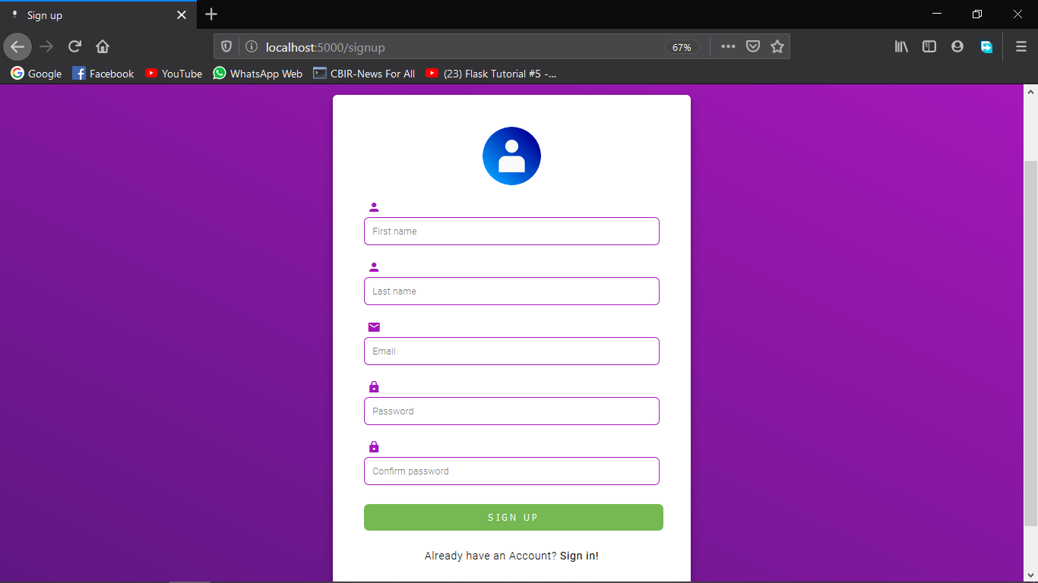
SIGN IN/User can log in by simply entering valid credentials
SIGN UP/user can easily sign up to become a register user by filling the required form

Slide 7
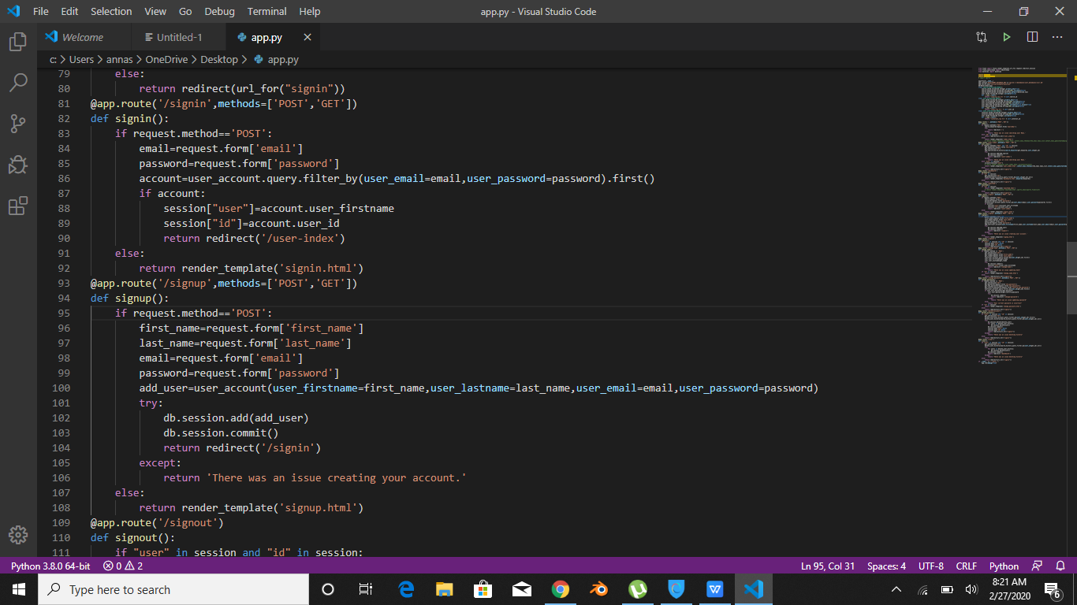
CODE FOR SIGN IN/SIGN UP

Slide 8
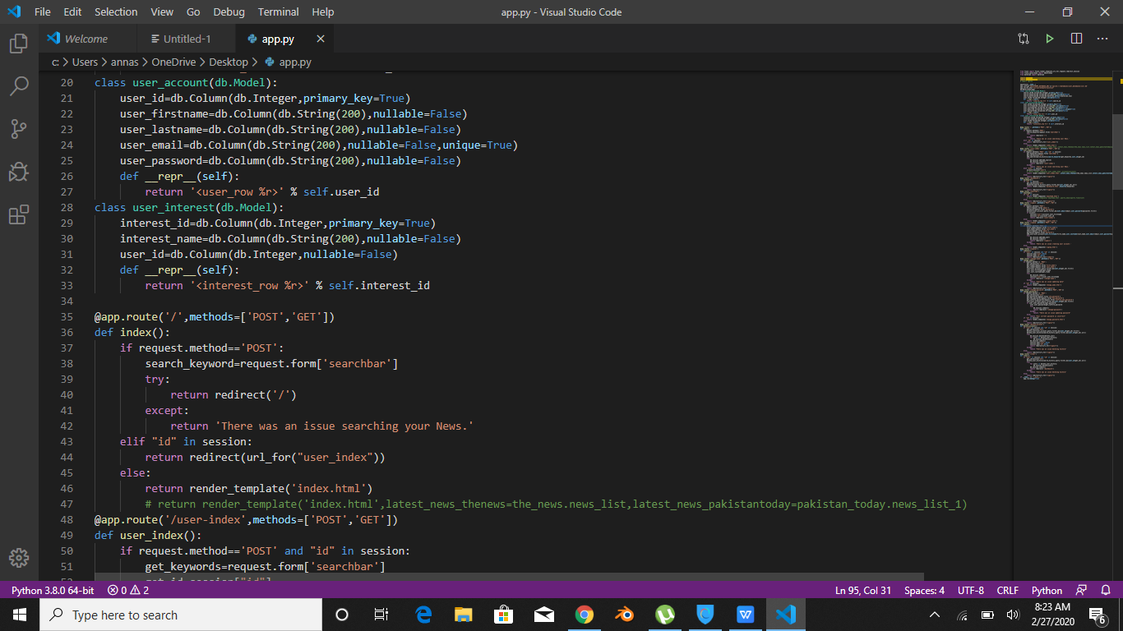
SIGN IN (PAGE HTML)

Slide 9
SIGN UP (FORM HTML)

Slide 10
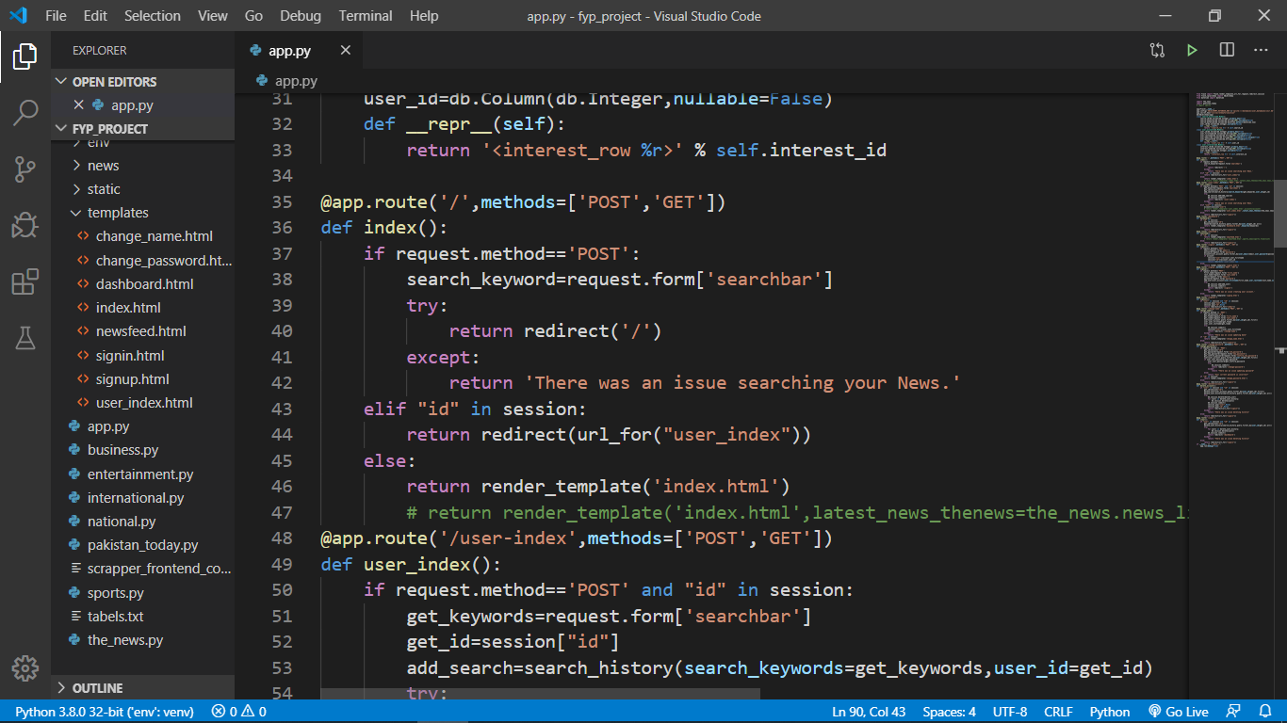
INDEX PAGE

Slide 11
SEARCH NEWS
1
User can search authentic and valid news by simplying entering keywords related to that specific news in search bar
2
LATEST NEWS
Latest news from the scrapped websites will be show on our landing and home page (after user login ) each time page load

Slide 12
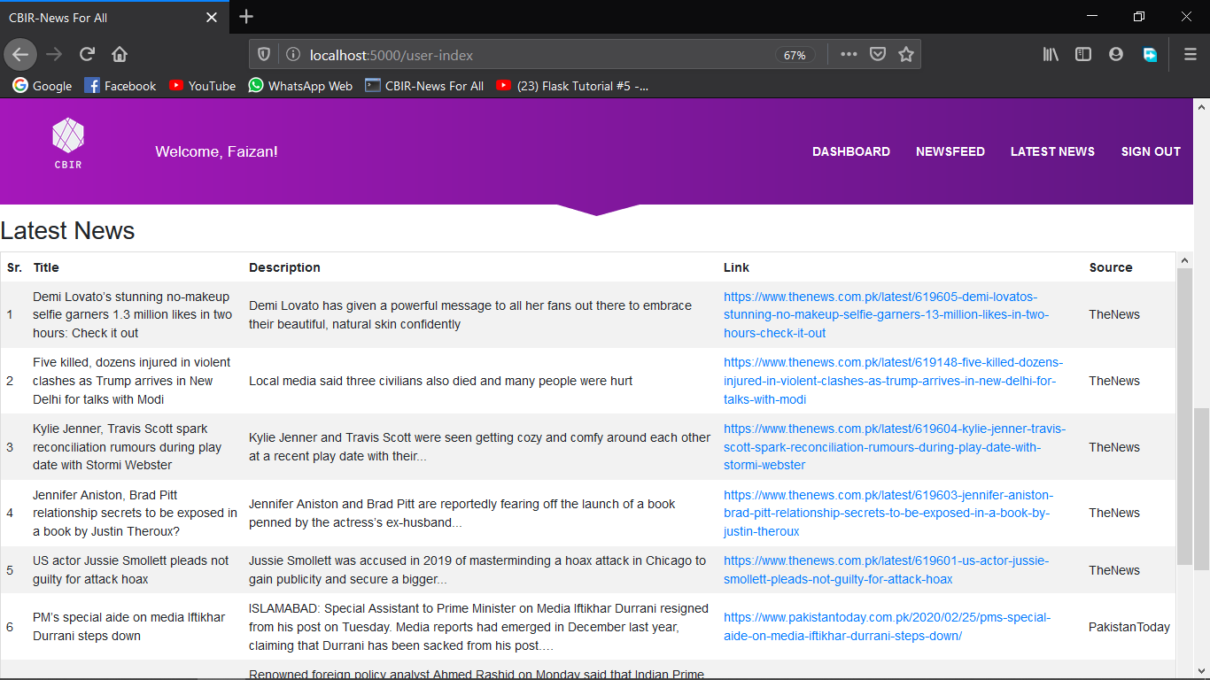

Slide 13
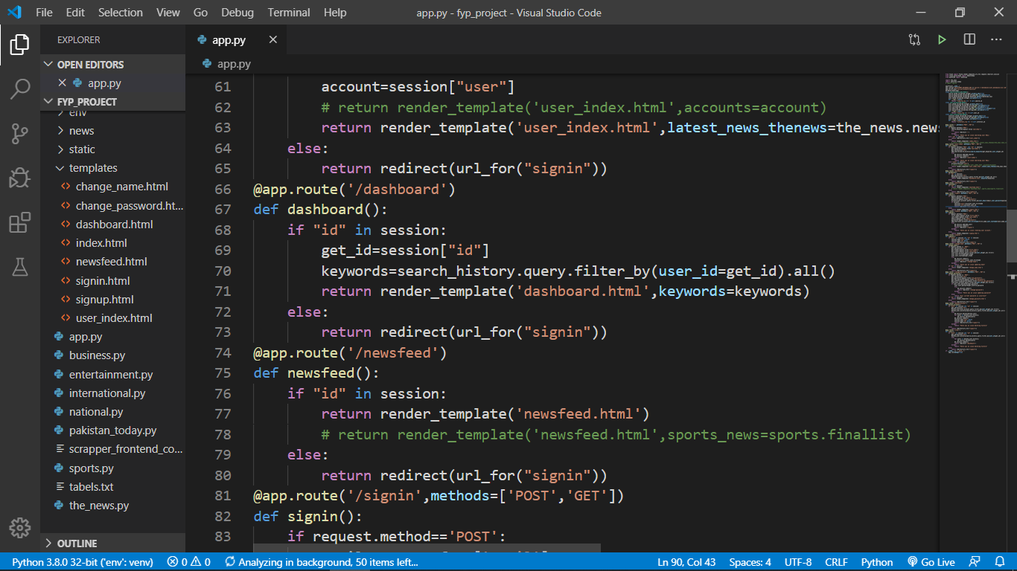

Slide 14
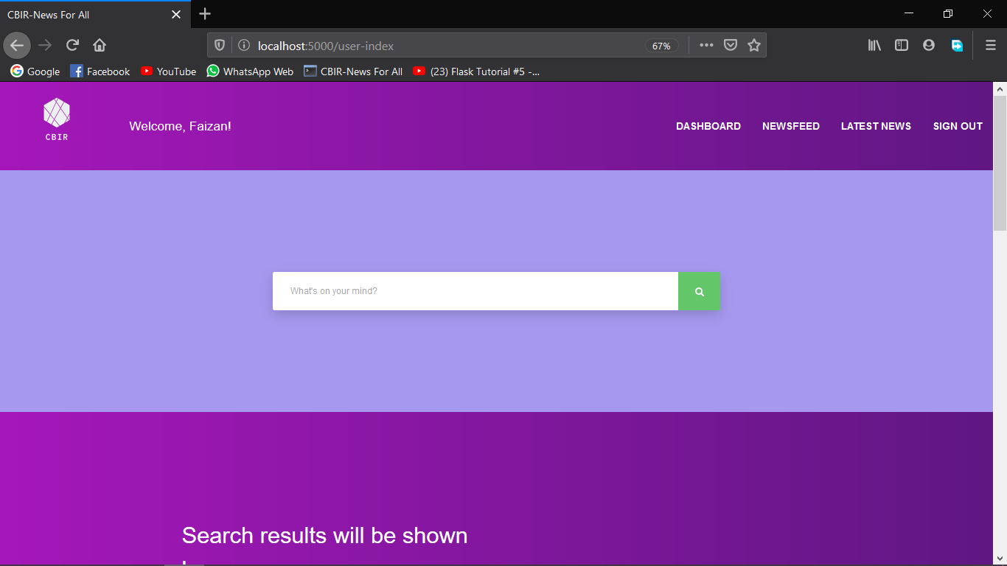
Dash board
Result News History
Search News History
After user successfuly login our dashboard will be appear with these options
whatever the user search in search bar will be maintain here
whatever the user search and data is scrapped and display is saved here as history

Slide 15
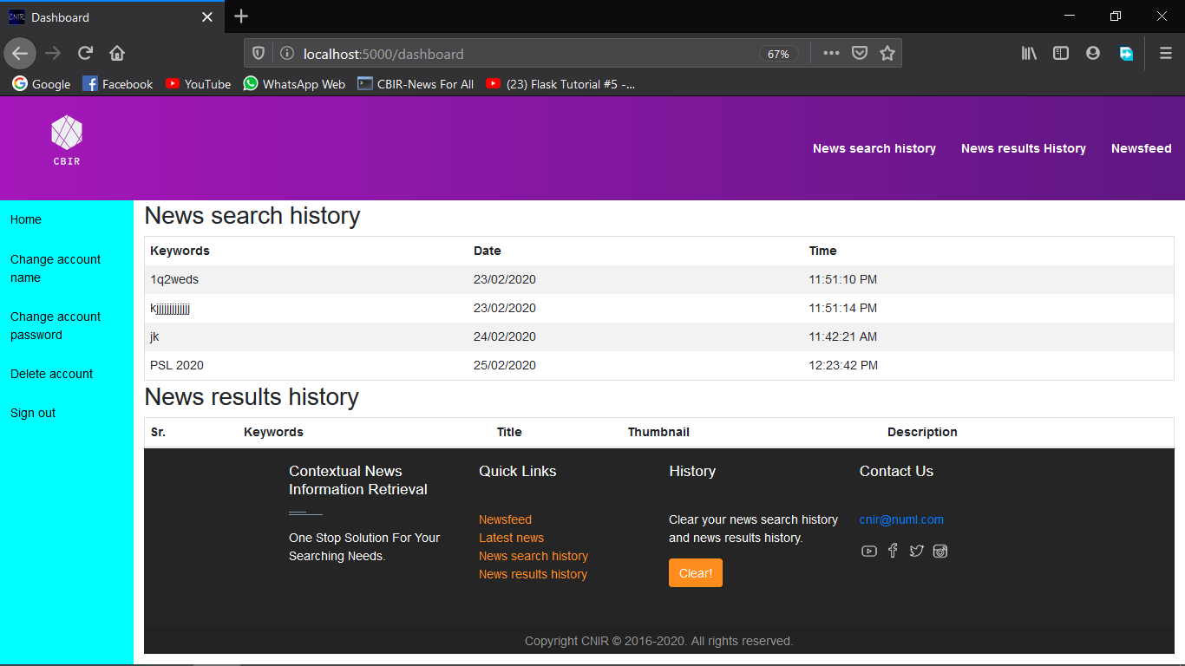
Add Title Here
S
W
Add Title Here
Add You Text Here Add You Text Here Add You Text Here Add You Text Here
Add You Text Here Add You Text Here Add You Text Here Add You Text Here
O
T
Add Title Here
Add Title Here
Add You Text Here Add You Text Here Add You Text Here Add You Text Here
Add You Text Here Add You Text Here Add You Text Here Add You Text Here

Slide 16
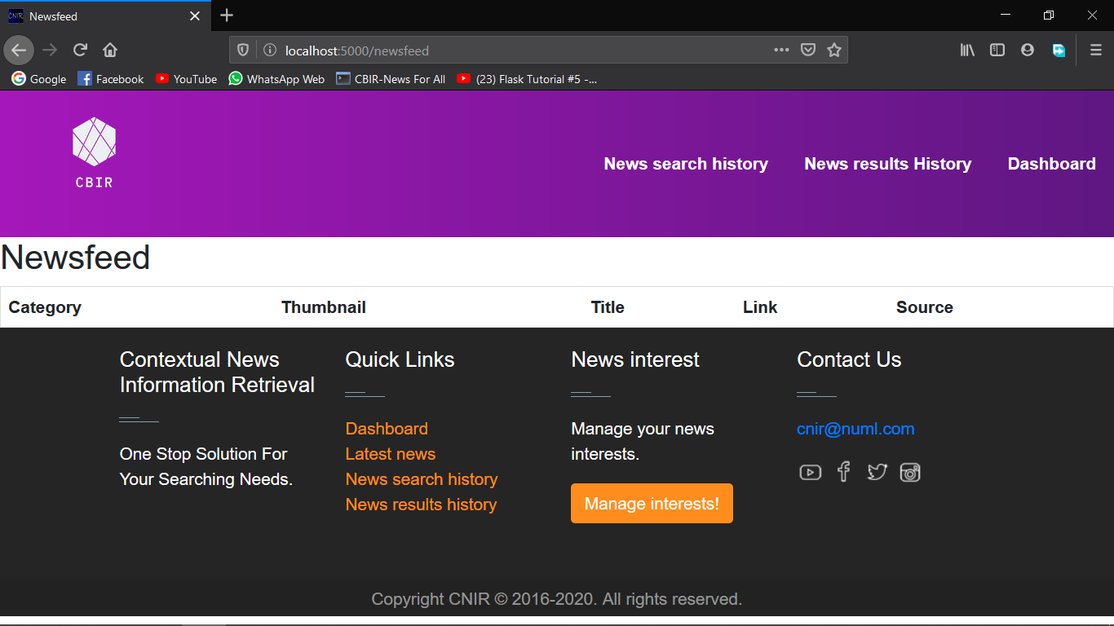

Newsfeed
The latest news according to the user interests will be displayed here

Slide 17
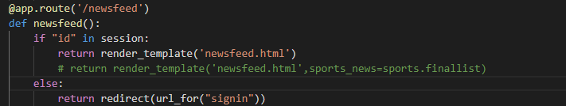
Code Of News Feed Functionality

Slide 18
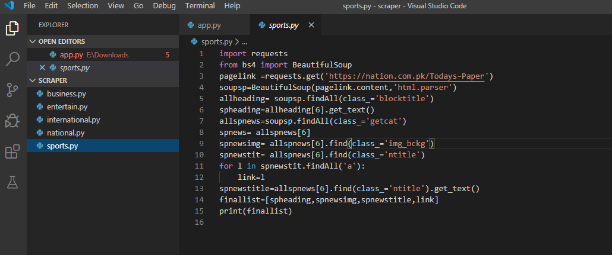
Code of interests news Scrapers

Slide 19
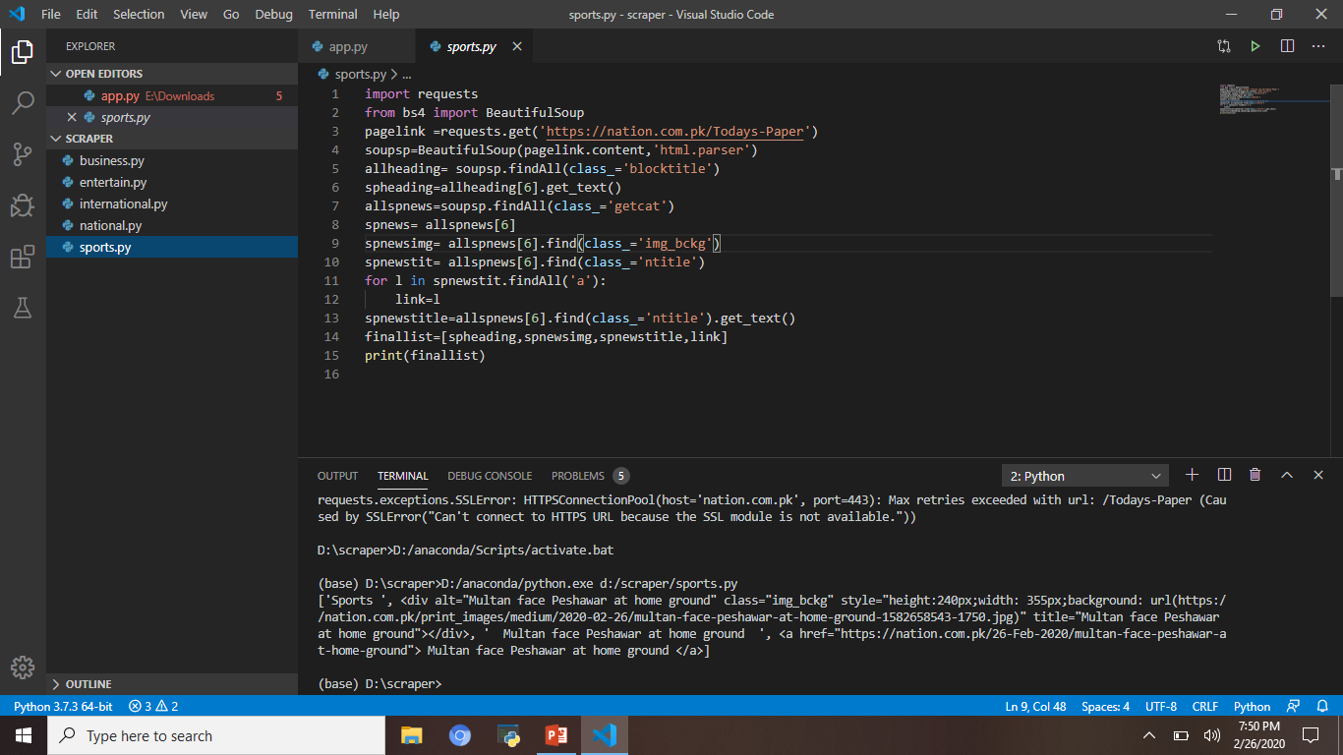
Terminal Output

Slide 20
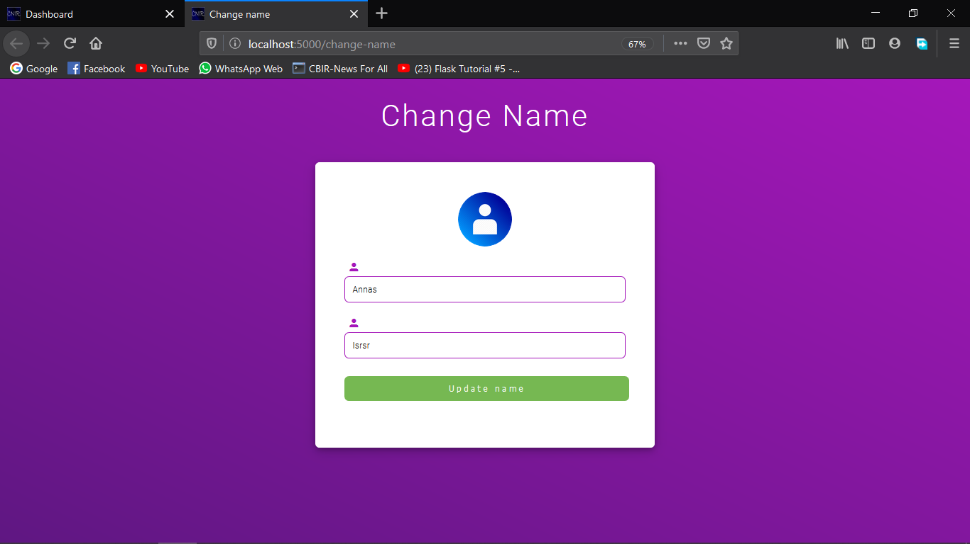
CHANGE ACCOUNT NAME
You can change your acount name from side bar change account name option

Slide 21
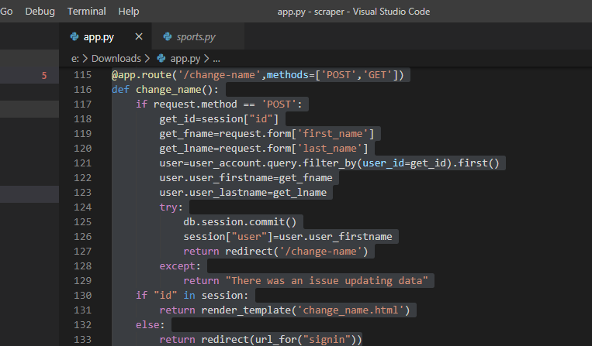
Code logic for Change name

Slide 22
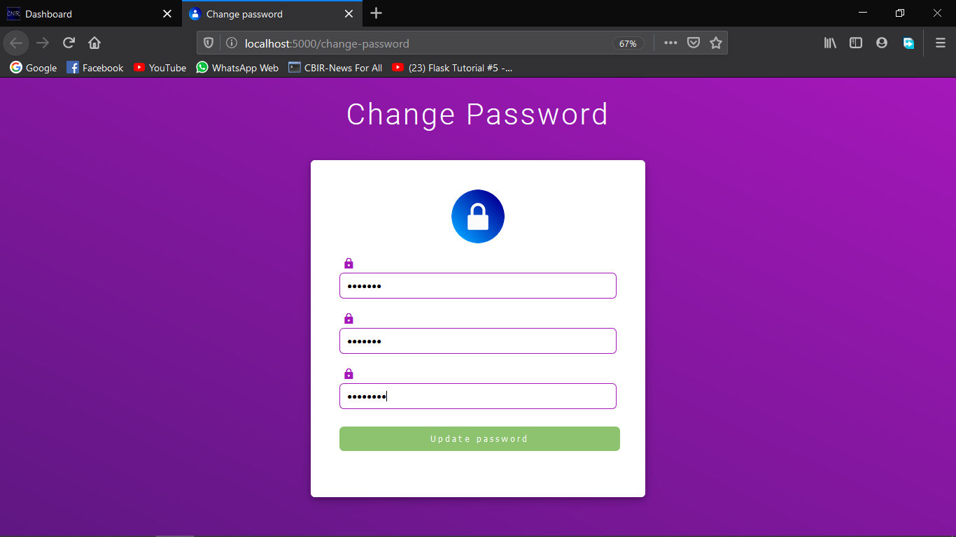
CHANGE ACCOUNT PASSWORD
password of your account would be changed if you click on change password option

Slide 23
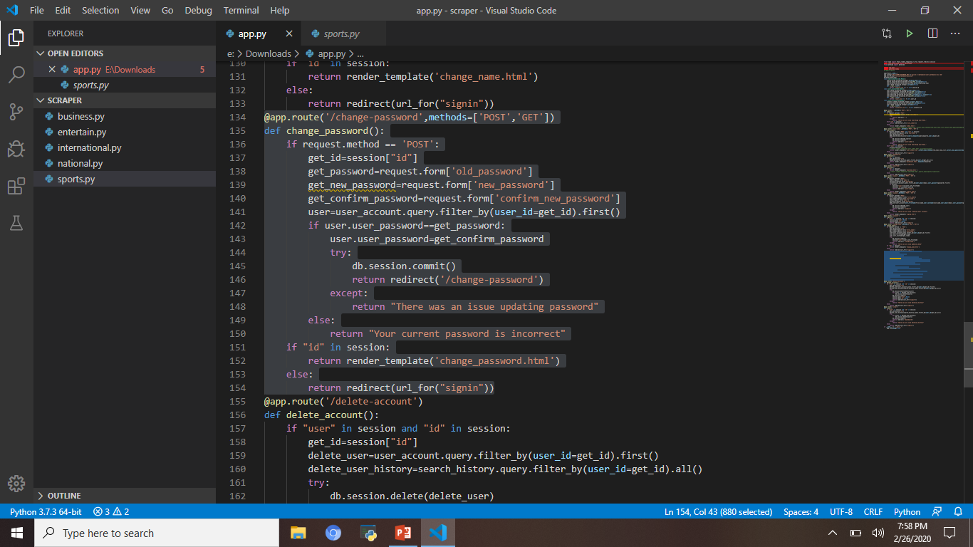
Code logic for Change Password

Slide 24
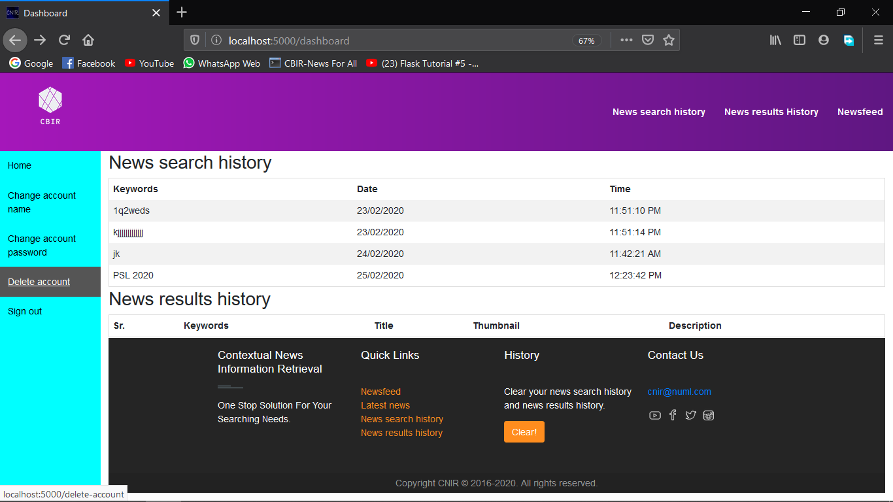
DELETE ACCOUNT
You can delete your accout from side bar delete account option

Slide 25
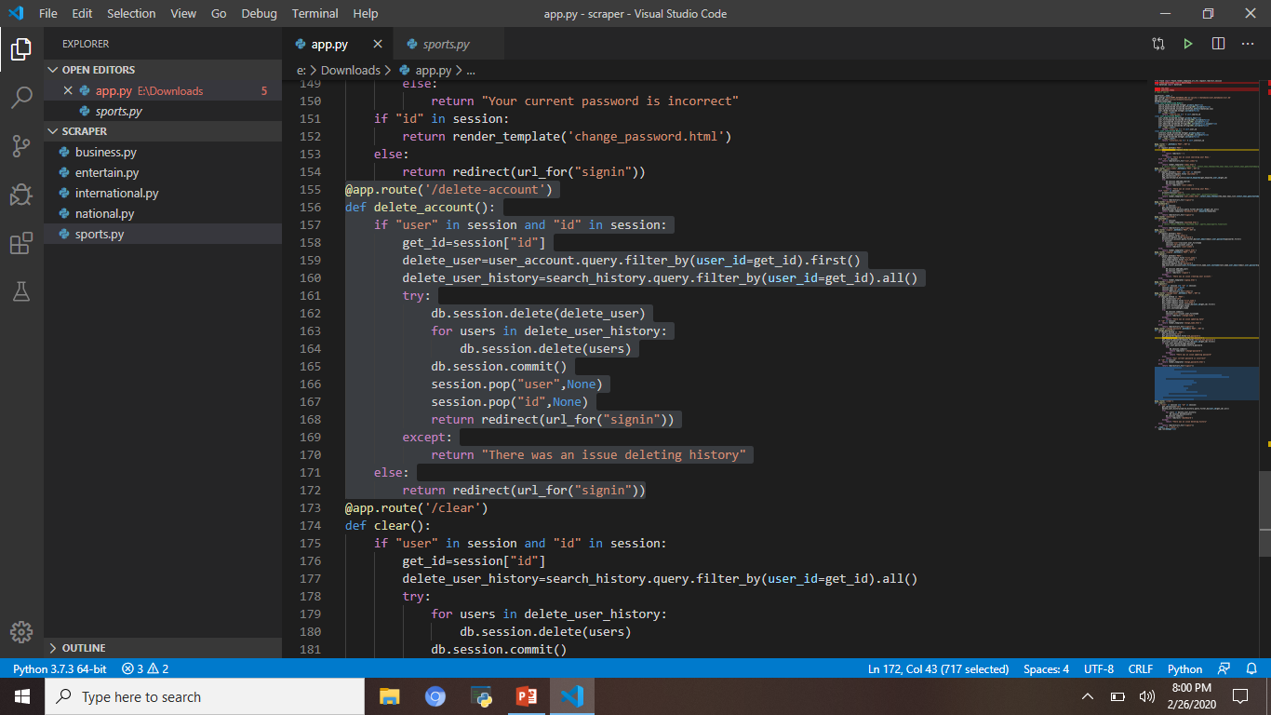
Code logic for Delete Account

Slide 26

s

